Slide 1

Image Caption Generator with Multilingual Translation using Deep Learning
22RH1A0570 G. Laxmi Prasanna
22RH1A05B1 K. Harini
22RH1A05B3 K. Sri varshini
Guide : Dr. Vishnu Kumar Misra

Slide 2
Introduction
"Image Caption Generator with Multilingual Translation using Deep Learning," aims to automate the process of generating meaningful textual descriptions (captions) for input images and translating those captions into various languages. With the rapid advancement in computer vision and natural language processing (NLP), systems that understand and describe visual data are increasingly in demand. This project uses state-of-the-art vision-language models and translation APIs to bridge the gap between images and multilingual human understanding.

Slide 3
Existing System
A deep learning-based encoder-decoder architecture. The encoder, a CNN such as InceptionV3, extracts high-level features from the input image. These features are then passed to an LSTM decoder, which generates captions word-by-word. The model is trained using large datasets containing paired images and captions, allowing it to learn meaningful representations. To improve performance, an attention mechanism can be incorporated, enabling the model to focus on different image parts while generating each word. This approach ensures better caption quality by dynamically attending to relevant visual features.

Slide 4
Proposed Solution
Proposed solution presents a single integrated application that accepts an image from the user, generates a relevant English caption using the BLIP model, and instantly translates that caption into the language selected by the user. This real-time interaction removes the need for post-processing and enhances user experience by making the tool accessible to speakers of various languages.

Slide 5
Key Features
Automated Captioning:
Uses BLIP model for accurate, context-aware image descriptions.
Multilingual Translation:
Supports Hindi, French, Spanish, German, Telugu, Tamil, Chinese.
Real-Time Processing:
Generates captions + translation in 2–5 seconds.
User-Friendly Interface:
Simple web UI for image upload and language selection.

Slide 6
Technologies Used
Deep Learning:
BLIP (Vision-Language Transformer) for captioning.
Hugging Face Transformers library.
Translation:
Google Translate API (google trans).
Backend:
Python, Flask (routing, model integration).
Frontend:
HTML/CSS for responsive UI.
Libraries:
PyTorch, TorchVision, Pillow (PIL).

Slide 7
Advantages of Proposed System
✅ Integrated Solution: Combines captioning + translation in one platform. ✅ Multilingual Support: Breaks language barriers. ✅ Real-Time Processing: No manual steps needed. ✅ Accessibility: Aids visually impaired and non-English users. ✅ Scalable: Easy to add more languages/models.

Slide 8
Modules
Image Upload & Preprocessing:
Handles file uploads (Pillow).
Caption Generation:
BLIP model extracts features and generates text.
Translation:
Google Translate API converts English captions.
Result Rendering:
Displays image + captions dynamically (HTML).

Slide 9
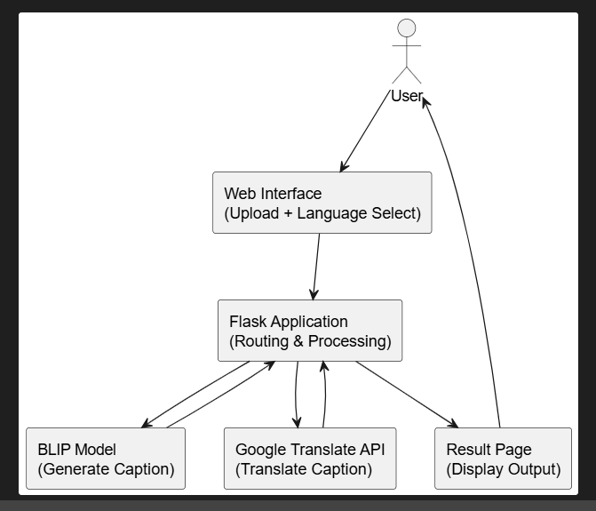
System Architecture

Slide 10
IMPLEMENTATION
The implementation can be divided into frontend and backend operations:
Frontend: The user interface is created using HTML and styled with CSS. It allows users to upload images and select their desired output language.
Backend:
app.py manages routing and logic handling.
caption.py loads the BLIP model and generates captions.
translation.py handles translation using google trans.

Slide 11
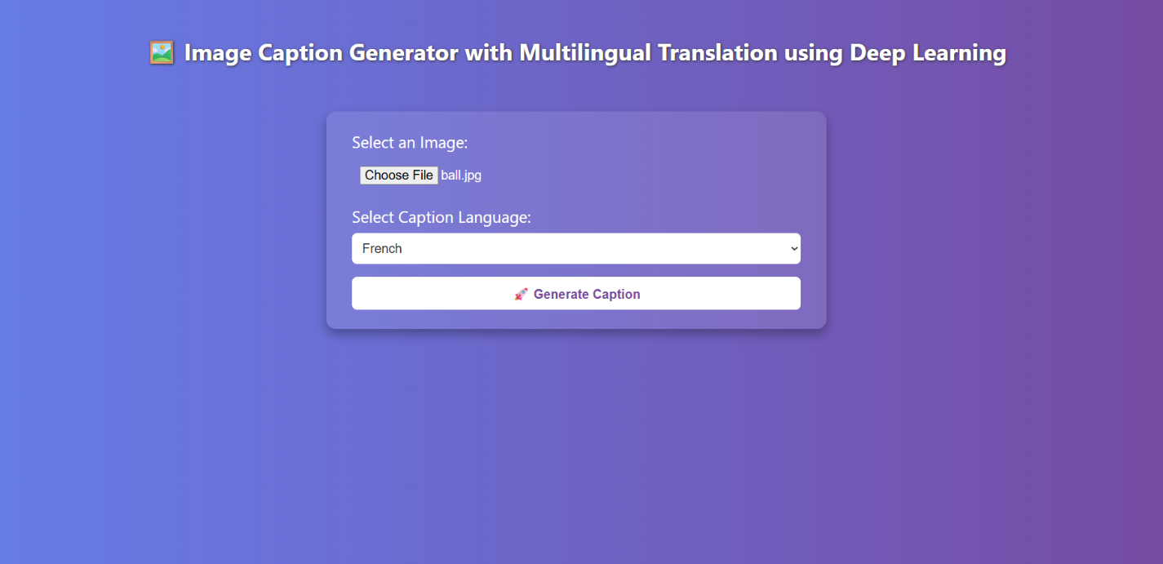
Output Screens

Slide 12
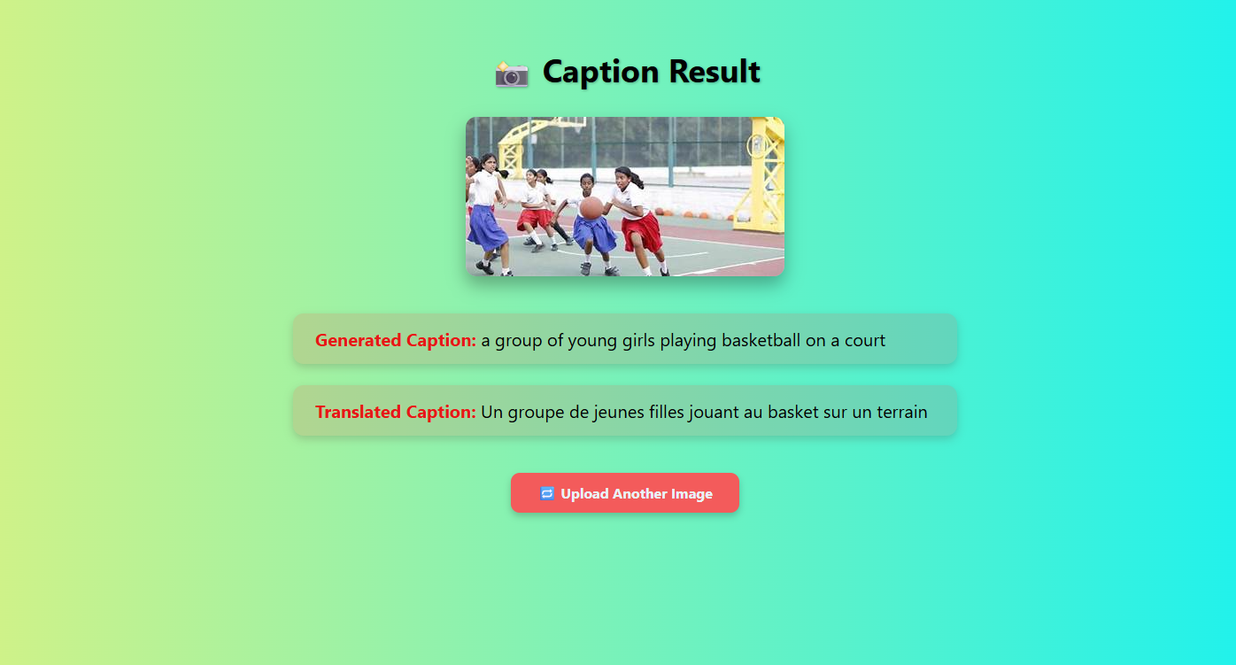

Slide 13
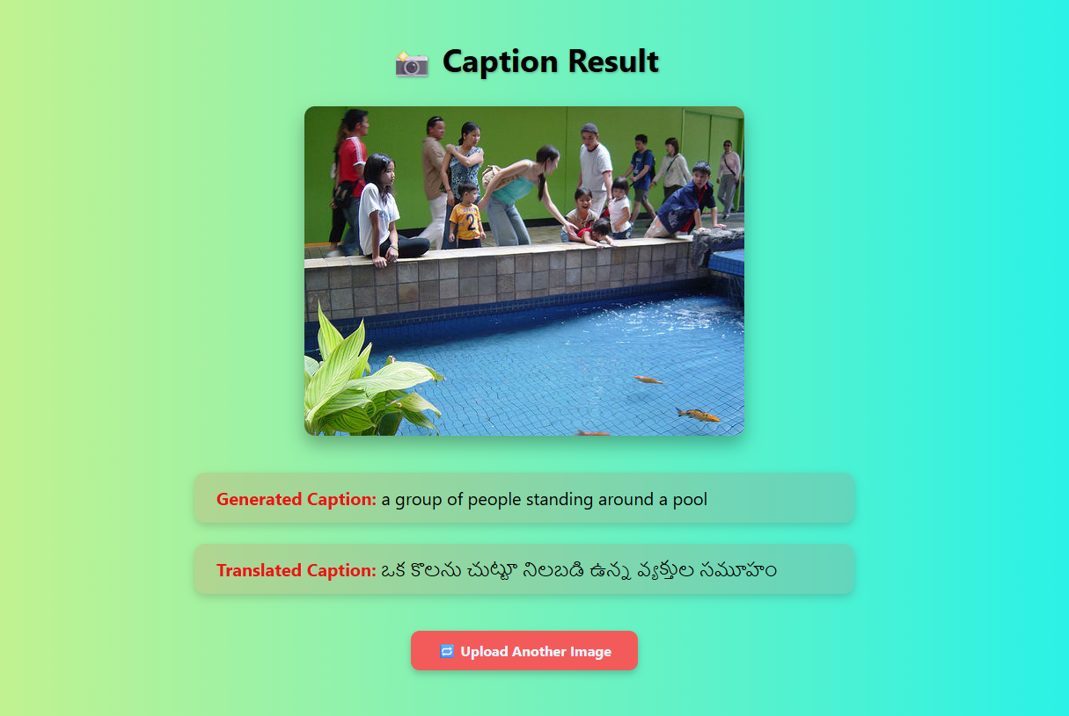

Slide 14
Conclusion
This project demonstrates the integration of deep learning and multilingual NLP into a single user-facing tool. It not only simplifies image understanding but also makes the results accessible to users across different linguistic backgrounds. The system is scalable, adaptable, and can serve as a base for applications in education, accessibility, and media automation.

Slide 15
References
Survey of Image Captioning Techniques
Link: https://arxiv.org/abs/2003.10120
BLIP (Bootstrapped Language Image Pretraining) Paper
Link: https://arxiv.org/abs/2201.12086
PyTorch Tutorials (Official)
Link: https://pytorch.org/tutorials/

Slide 16
THANK YOU

